Slide 1


Company New Project Location Detector
IMPOSTER MIND

Slide 2






Meet Our Team
195997
198879
198989
199121
199008
Tan Sean Leng
Haliza Azzafirah binti Abdul Halim
Adilah binti Adi Yasran
Aimi Nazihah binti Helwany Had
Nur Nadiah binti Ruslan
Programmer
Programmer
Programmer
Programmer
Programmer

Slide 3
PURPOSE
Company New Project Location Detector
01
02
To notify the internal users when external users are near to their company new project site.
To help external users to shorten visiting cost.
03
04
To help internal users of the project prepare themselves if the external users confirm that they will come within expected time.
To notify the external users when they are near to company new project to visit.

Slide 4
SCOPE
1
Developing new and secure remote work and collaboration solutions.
2
Investigating future working and collaboration solutions.
3
Overcoming the problem of remote work and collaboration.

Slide 5
Requirements
Company New Project Location Detector
Forth Requirement
Third Requirement
User shall be notified when the user location is 1km to 10km near to the construction site.
Second Requirement
System shall be able to detect external user location and location of the project construction site.
First Requirement
Users shall able to sign in into the application using the registered email and password.
User shall be able to register into application using email and password.

Slide 6
System Architecture
Company New Project Location Detector Application use three-tier architecture that consists of three separate layers which are presentation layer, application layer and database layer. Presentation layer is the layer presents data to the user and optionally permits data manipulation and data entry, also this layer requests the data form Business layer. Application layer is middle-tier components are not tied to a specific client, they can be used by all applications and can be moved to different locations, as response time and other rules require. Database layer is made up of the DBMS that provides all the data for the above two layers.

Slide 7
Architecture
Diagram

Slide 8
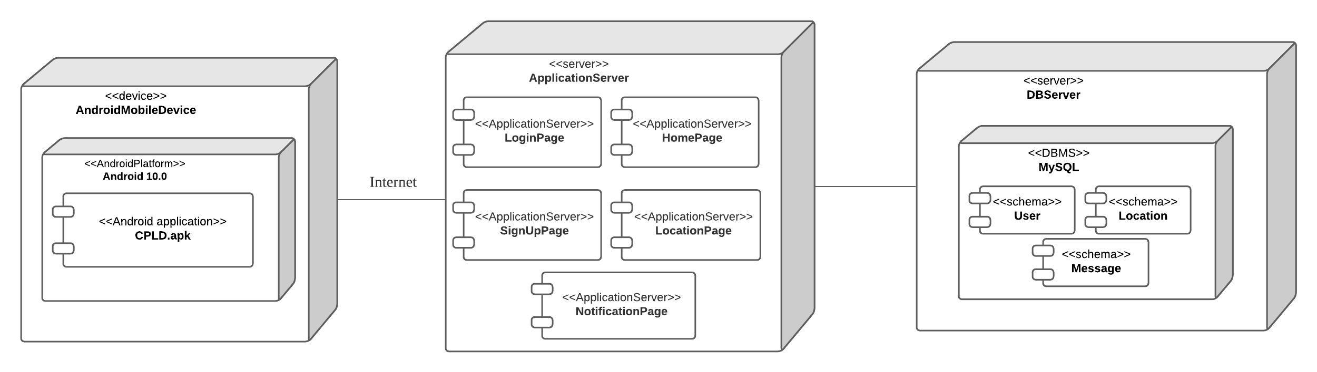
Deployment Diagram
The deployment diagram consists of 3 nodes. Hardware devices used for the first node is Android Mobile Device in order to assess the application server. The platform used compatible for the mobile application is Android 10.0. The user need internet connection to access the application. The second node is ApplicationServer that provide services and networking access to the user. The application server communicates with database server which is the third node to access the data of user, location and message log.

Slide 9
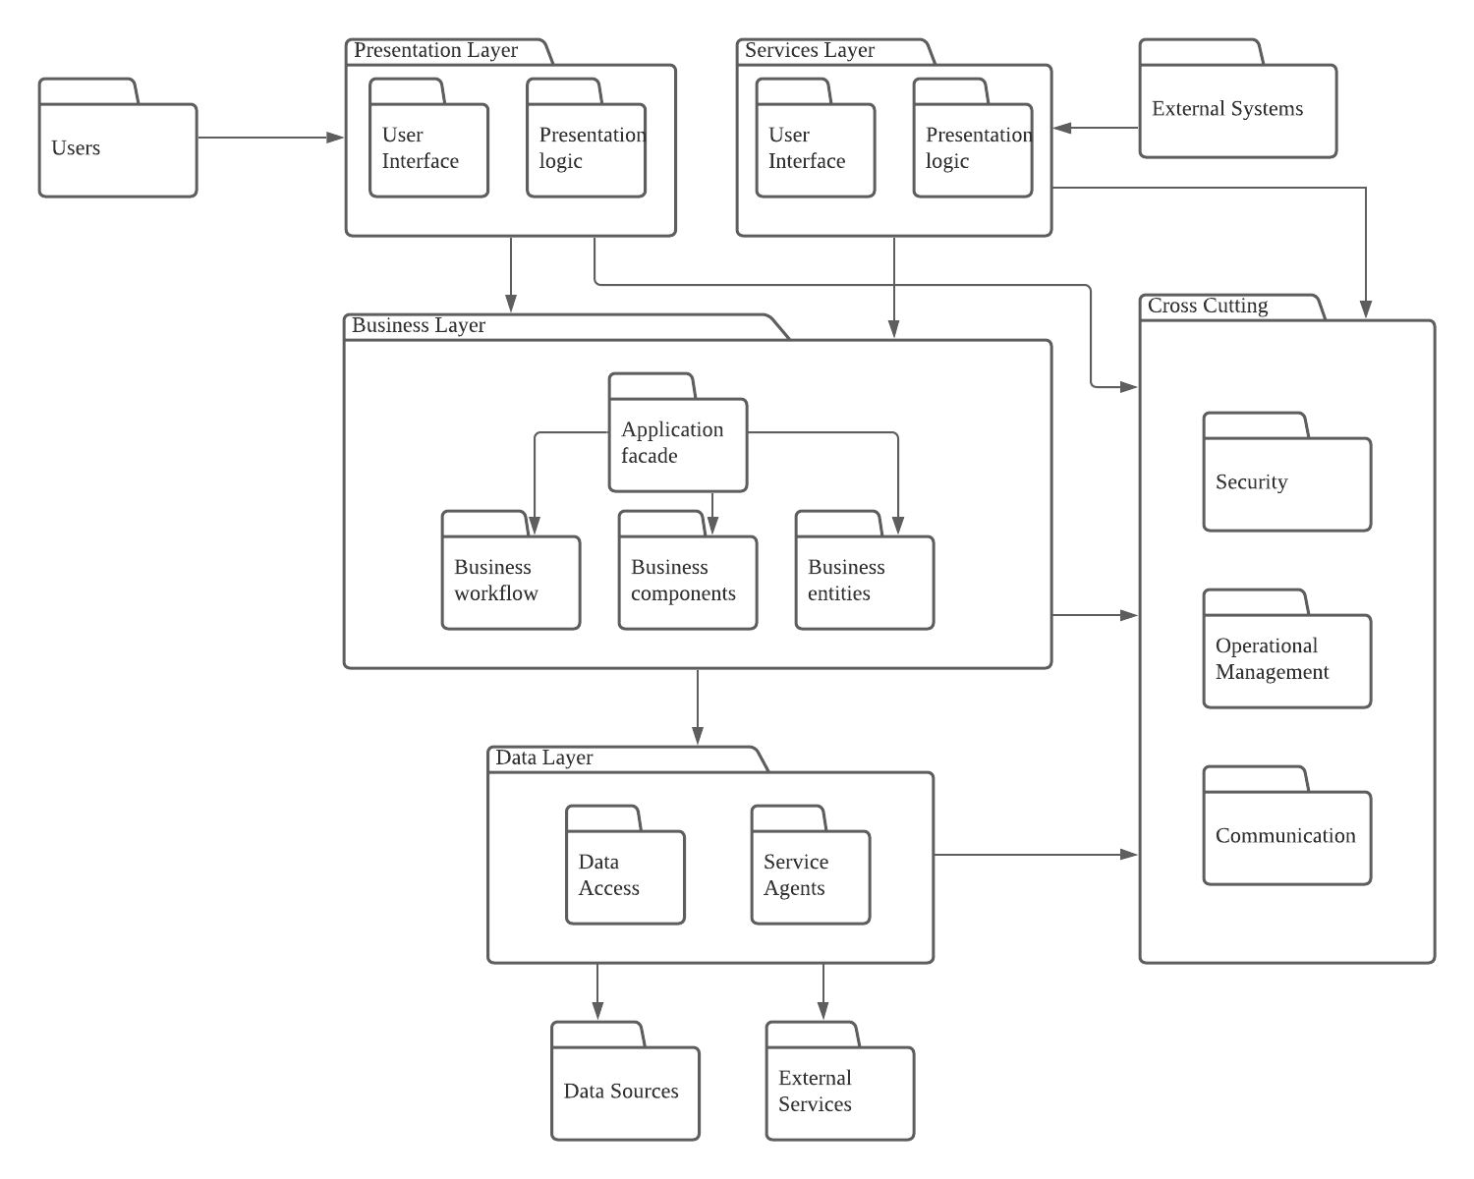
Package Diagram
Users package depends on Presentation Layer package while External System package depends on Services Layer package.
There are dependencies between Presentation Layer and Business Layer, Presentation Layer and Cross Cutting, Services Layer and Business Layer, Services layer and Cross Cutting, Business Layer and Data Layer, and Business Layer and Cross Cutting.
Data Layer package depends on external packages which are Data sources and External Services.

Slide 10
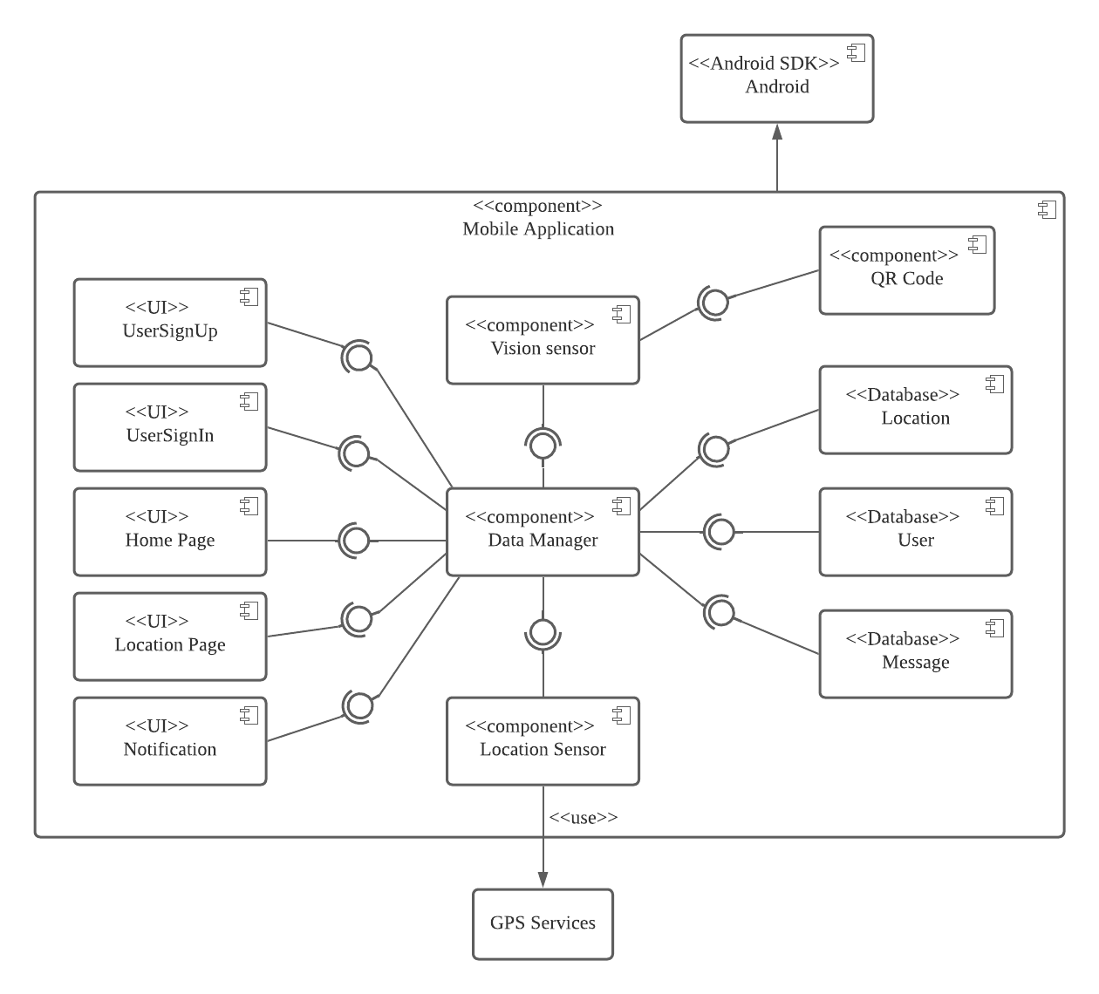
Component Diagram
The component diagram has AndroidSDK Android to interact with Mobile Application component. The Mobile Application component consists of user interfaces components such as UserSignUp, UserSignIn, HomePage, LocationPage and Notification. Location Sensor component use GPS services to track user’s location. Vision Sensor has QR code component to recognize users. Databases involved include Location, User and Message.

Slide 11


Business Model
Target customers
Key activities
Construction workers
Engineers
A
The key activities of this business is :
To ease users in finding new company project sites
To shorten visiting cost of external user (outside worker)
Required resources
B
This project business operates databases that are very useful to contain information and location of places.
Branding and user communities are also the required resources of this project business.
C
D
Stakeholders
HILTI employees, collaborated company employees, investor, customer
Channels
Cost structure
Website for advertisement
Deploy the application through google store and app store.
F
The cost of this project business include :
The marketing advertisement to attract user
The salaries of employers such as software engineer and designer.
The server and framework for this mobile application

Slide 12
Global Positioning System (GPS)
Technological Innovation
This project use a smartphone’s
GPS technology to track a location of user, if the user has allow it.
GPS can offer accuracy of tens of kilometers to the nearest places.
QR code and facial recognition
Internet of things(IoT)
IoT can be used to increase operational efficiency with remote monitoring and equipment management, IT infrastructure, enhanced security by enable intrusion detection system and protection of remote sites.
QR code is use to authenticate the users by scanning the employment card using the vision sensor.
Facial recognition also helps to identify the user to make sure the face is same with the employment card.

Slide 13
Technological Innovation
Sensors
In supporting high-accuracy, ubiquitous, indoor and outdoor locations, sensors have been described as a key element. It will allow consistent performance across a variety of different environments, combined with GPS, Wi-Fi and other technologies.
Wi-Fi (wireless LANs) and
Cellular network ( 2G/3G/4G)
Both Wi-Fi and cellular network offer the location accuracy in the order of ten kilometers
Google Map API
Google Map API is used to integrate and
collaborate between the application and the companies’ location, so that if a new
company project is detected by the
application, the location will be shown on the map.

Slide 14
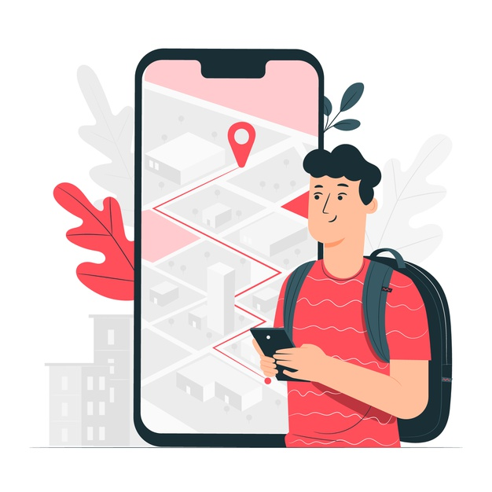


Customer Perspective
Company New Project Location Detector
01
02
03
Easy to Find Location
Less Travel Expenses
Save Time
External users can find nearest construction site easily by receiving notification.
External users can save fuel and money.
External users can arrive to desired destination at expected time.

Slide 15


Internal User's Perspective
Company New Project Location Detector
01
02
Early Preparation
Prevent Waste of Time
Internal user can do early preparation if they get confirmation that the external user will come to their company new project site within the expected time.
Internal user can avoid wasting time when external user has cancelled the visit to their company site.

Slide 16
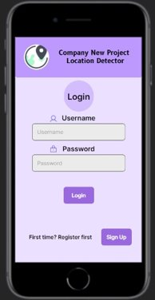
Login Interface
Firstly, a registered user needs to log in into the system by using confidential username and password. Once the user successfully logged in, the system will redirect the user into the main page of the system, while if the user enters wrong username or password, the user cannot enter the system and “Wrong Username and Password” message will be displayed.
Notes:
Internal User’s Perspective: The integration of the new solution into the current system should be straightforward and not resulting in increased downtime or constant need for workarounds.

Slide 17
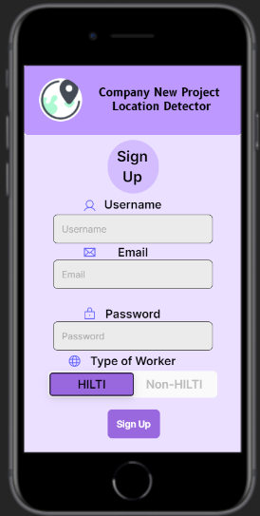
Sign Up Interface
First of all, an unregistered user needs to sign up first if he or she does not own an account in the system. Once the user had registered successfully by filling up the confidential username, email, password and type of worker correctly, he or she will be redirected to the home page of the application and the data will be saved into the database of the system.
Notes:
Internal User’s Perspective: The integration of the new solution into the current system should be straightforward and not resulting in increased downtime or constant need for workarounds.

Slide 18
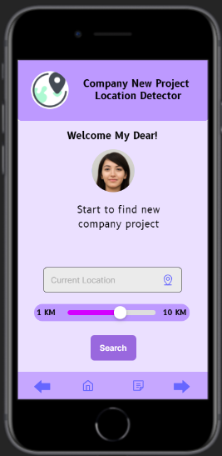
Home Interface
The home page will be shown after the registered user had logged in or signed up into the system. In this interface, the user needs to locate his or her current location by tapping the "location" icon, the user needs to turn on their GPS location sensor so the system can access to their location easily. After that, the user needs to adjust the search radius which range from 1 to 10 km. Once the user has finished the above operation, user need to tap the "Search" button and the system will search for the nearest Hilti’s projects location within the desired range. Then, the user will be redirected to the result page.
Notes:
Internal User’s Perspective: The integration of the new solution into the current system should be straightforward and not resulting in increased downtime or constant need for workarounds.

Slide 19
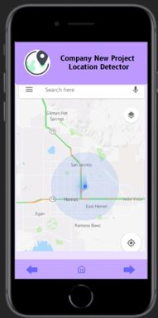
Detect Company New Project Interface
The result page will show the result of the nearest Hilti’s projects that had been detection within the desired range in this interface. If a company with new project related to Hilti’s technology has been found within the searched radius, the company site will be detected and shown in the Google map of the user’s mobile phone.
Ck to add text
Notes:
Internal User’s Perspective: The integration of the new solution into the current system should be straightforward and not resulting in increased downtime or constant need for workarounds.

Slide 20
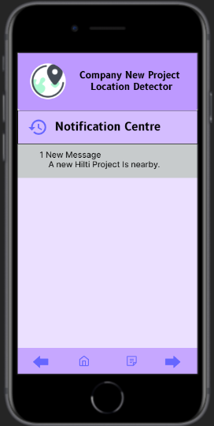
Notification Centre Interface
If a company with new project has been found within the searched radius, a notification will be popped up in the notification center.
Ck to add text
Notes:
Internal User’s Perspective: The integration of the new solution into the current system should be straightforward and not resulting in increased downtime or constant need for workarounds.

Slide 21

CONCLUSION
Company New Project Location Detector
In conclusion, Company New Project Location Detector is a project which is designed to help users to discover new company projects near the users’ locations with collaboration among the companies. .

Slide 22
Thank you
Company New Project Location Detector

